Slide 1
CHAPTER 1 The essential of software requirement

Slide 2
Objectives
Understand some key terms used in the software requirements domain.
Distinguish product requirements from project requirements.
Distinguish requirements development from requirements management.
Be alert to several requirements-related problems that can arise

Slide 3
Contents
Why is requirement engineering?
Software requirements defined
Requirements development and management
When bad requirements happen to good people
Benefits from a high-quality requirements process

Slide 4
Why is requirement engineering?
Distribution of Defects
Distribution of Effort to Fix Defects
Code
7%
Code
1%
Other
4%
Requirements
56%
Other
10%
Design
13%
Requirements
82%
Design
27%
Source: Martin & Leffinwell

Slide 5
Software requirements defined
Brian Lawrence: “anything that drives design choices” (Lawrence 1997)
“ Requirements are a specification of what should be implemented. They are descriptions of how the system should behave, or of a system property or attribute. They may be a constraint on the development process of the system” Ian Sommerville and Pete Sawyer (1997)

Slide 6
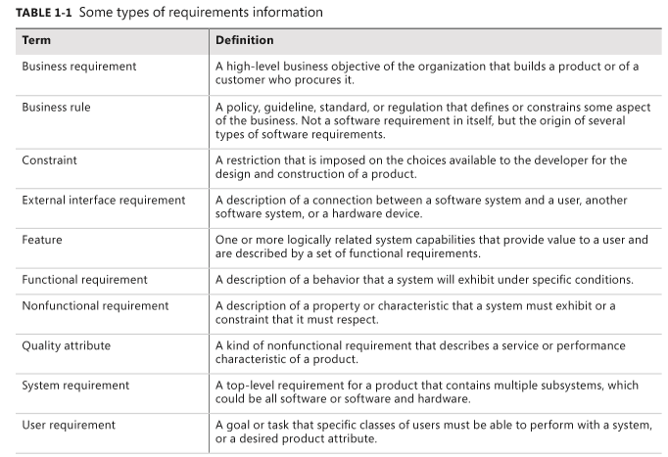
Types of requirements

Slide 7
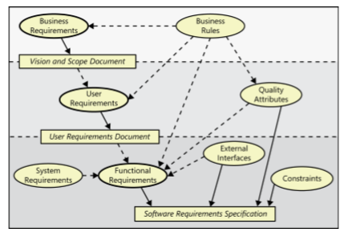
Levels and types of requirements

Slide 8
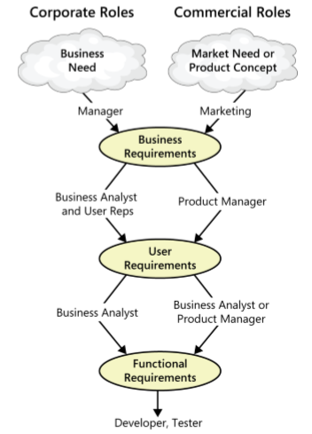
The participation of stakeholders in requirements development
Notes:
Working with three levels

Slide 9
Product vs. project requirements
Product requirements:
properties of a software system to be built
Projects requirements:
do have other expectations and deliverables that are not a part of the software the team implements, but that are necessary to the successful completion of the project as a whole
Notes:
Teacher should explain more detail about every type of requirements

Slide 10
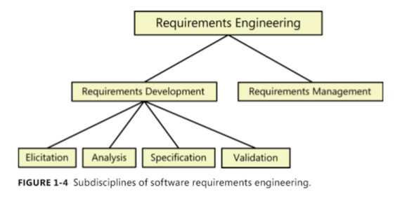
Requirements development and management
Notes:
Teacher should explain every step

Slide 11
When bad requirements happen to good people
Insufficient user involvement
Inaccurate planning
Creeping user requirements
Ambiguous requirements
Gold plating
Overlooked stakeholders

Slide 12
Benefits from a high-quality requirements process
Fewer defects in requirements and in the delivered product.
Reduced development rework.
Faster development and delivery.
Fewer unnecessary and unused features
Lower enhancement costs
Fewer miscommunications.
Reduced scope creep.
Reduced project chaos.
Higher customer and team member satisfaction.
Products that do what they’re supposed to do.
(10)
=> Tóm lại là giúp phát triển phần mềm nhanh , chính xác, tiết kiệm tiền và tăng sự hài lòng của người dùng

